Slide 1
WELCOME

Slide 2
INTRODUCTION
BSMDM-2021 - Army Initiative as a part of celeb “ Mujib Borsho”
The motto - “মুজিববর্ষে ডিজিটাল ম্যারাথন ডিজিটাল বাংলাদেশ ”
Showcase event - Dhaka on 10 Jan – 200 participants (35 of 15 countries)
Closing - 07 Mar 2021, 10 lacs participants

Slide 3
AIM
To apprise the planning and progress of BSMDM-2021 in Rangpur Area

Slide 4
SCOPE
Responsibility of Rangpur Area
Distribution of tasks
Process of Registration & Run
State of progress
Action Plan/ Recommendations

Slide 5
RESPONSIBILITY OF RANGPUR AREA
Ensure participation of 80,000 participants
10,000 Mil (min) &
70,000 Civ pers by 7 Mar 2021

Slide 6
DISTRIBUTION OF RESPONSIBILITY
SER | DISTRICT | TOTAL POP | TARGET | COORDINATING MILITARY OUTFIT
1 | DINAJPUR | 31.09 Lac | 13,500 | 11 EB, 36 BIR & 4 H
2 | RANGPUR | 29.96 Lac | 15,000 | 34 EB, 9 ENGRS
3 | GAIBANDHA | 24.72 Lac | 8,000 | 24 & 32 Fd Regt Arty
4 | NILPHAMARI | 19.07 Lac | 8,000 | 20 Fd & 19 Med Regt Arty
5 | KURIGRAM | 20.59 Lac | 10,000 | 30 BIR, 2 SIGS
6 | THAKURGAON | 14.67 Lac | 10,000 | 29 BIR, 4 EB
7 | PANCHAGARH | 9.87 Lac | 6,000 | 2 BIR
8 | LALMONIRHAT | 12.56 Lac | 10,000 | 25 BIR
 | TOTAL | 1.6 Crore | 80,500
562/70,000
237
(.3%)
(.8%)
7

Slide 7
DIGITAL MARATHON REGISTRATION VIA APPS

Slide 8
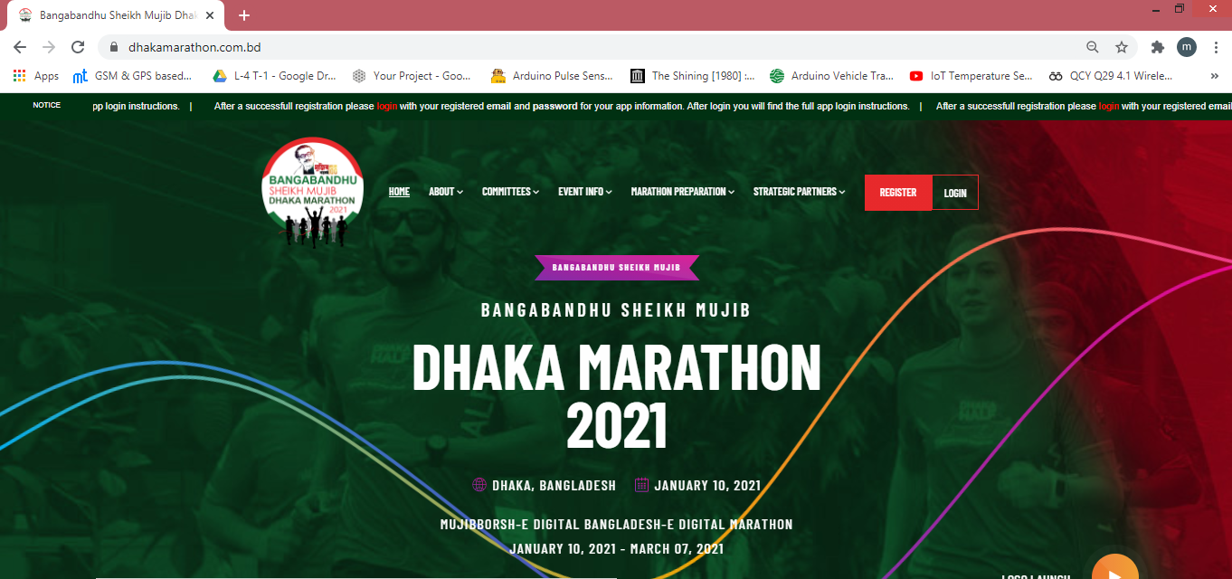
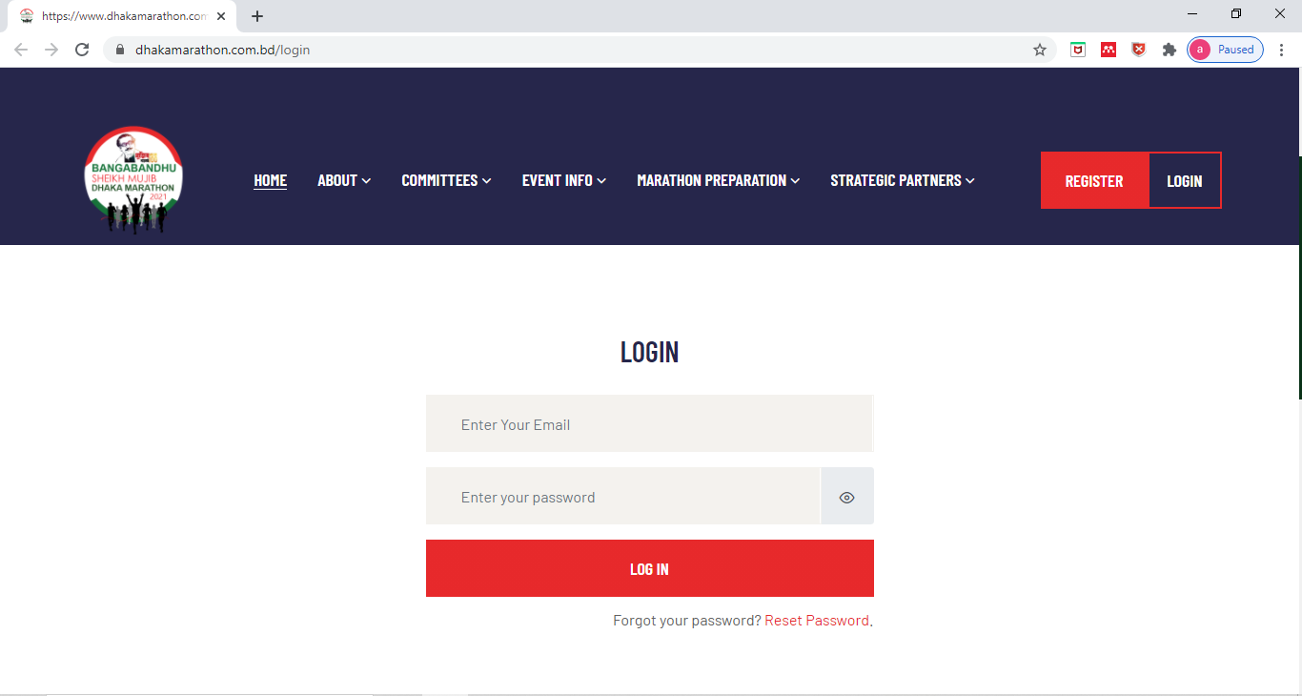
DIGITAL MARATHON REGISTRATION VIA APPS
Step 1
Click the Link: www.dhakamarathon.com.bd/login
freeadmin2@marathon.com.bd
freeadmin@2

Slide 9
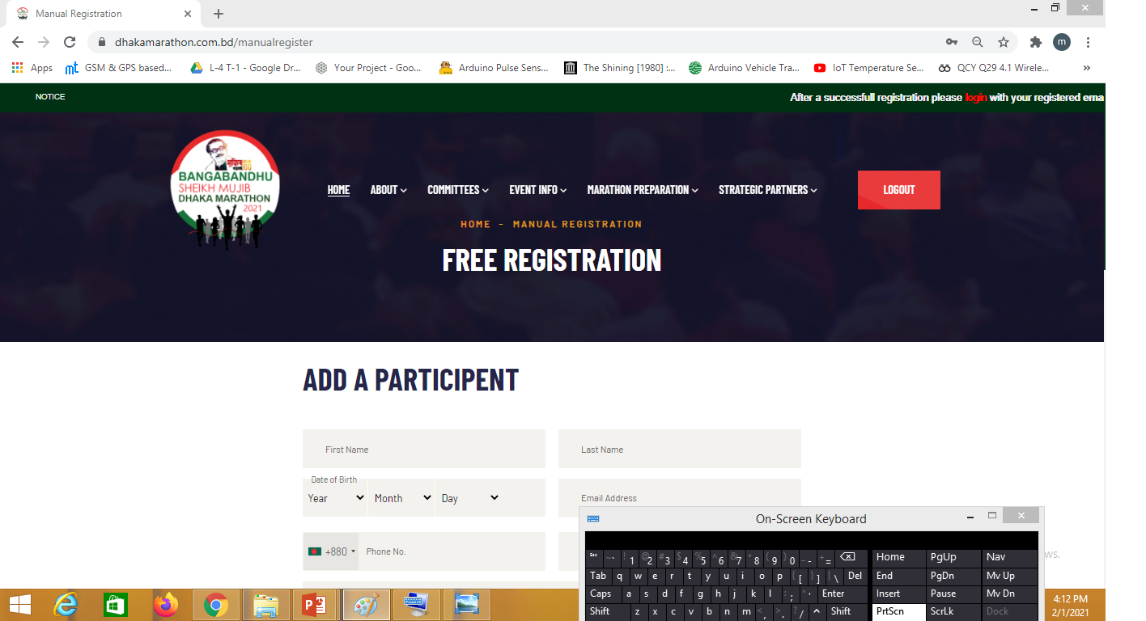

Slide 10
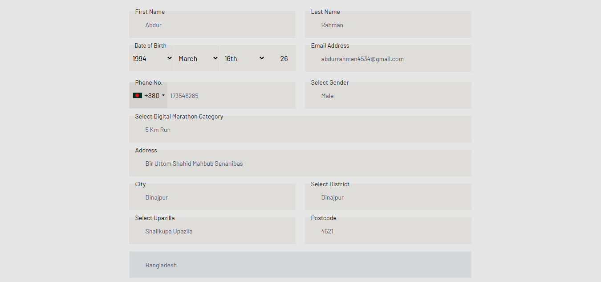
abdurrahman4534@gmail.com
Enter your
Email here
Fill up all the
information

Slide 11
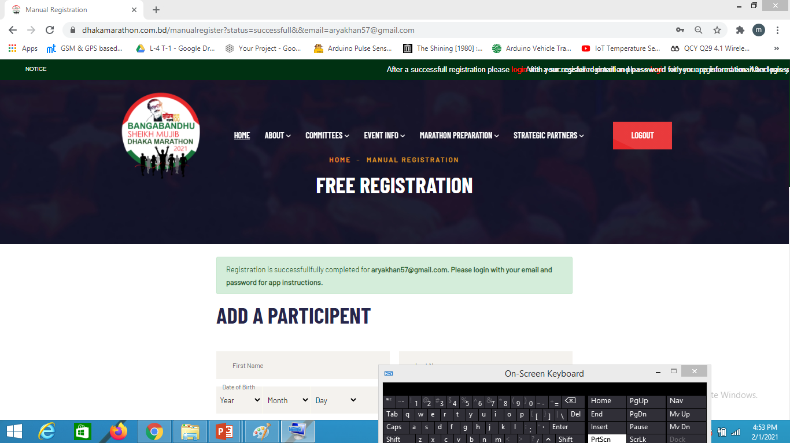
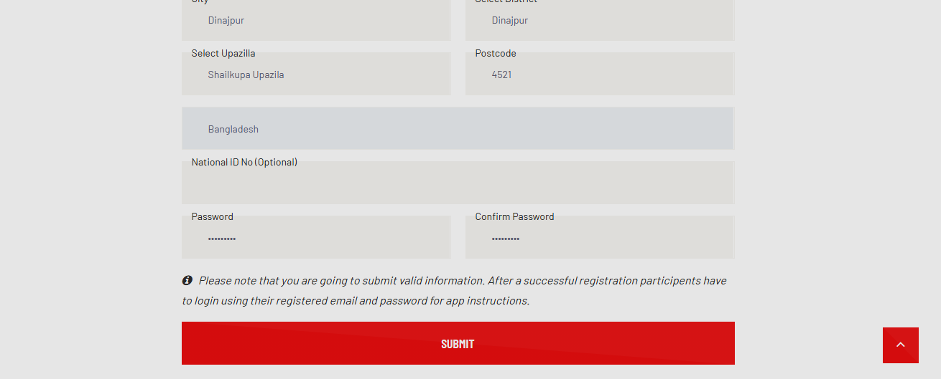
Enter
Password
here

Slide 12
DIGITAL MARATHON REGISTRATION VIA APPS
1st step completed
2nd step: Open
Google play store
on your
Android phone

Slide 13
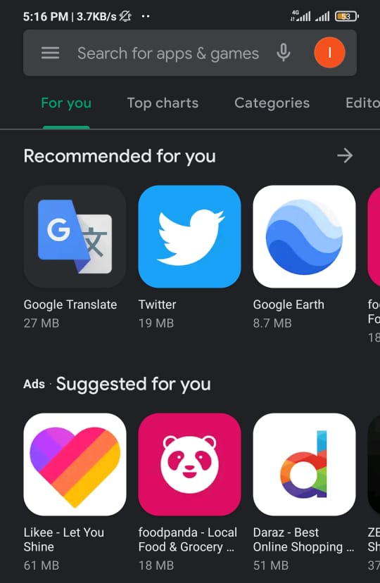
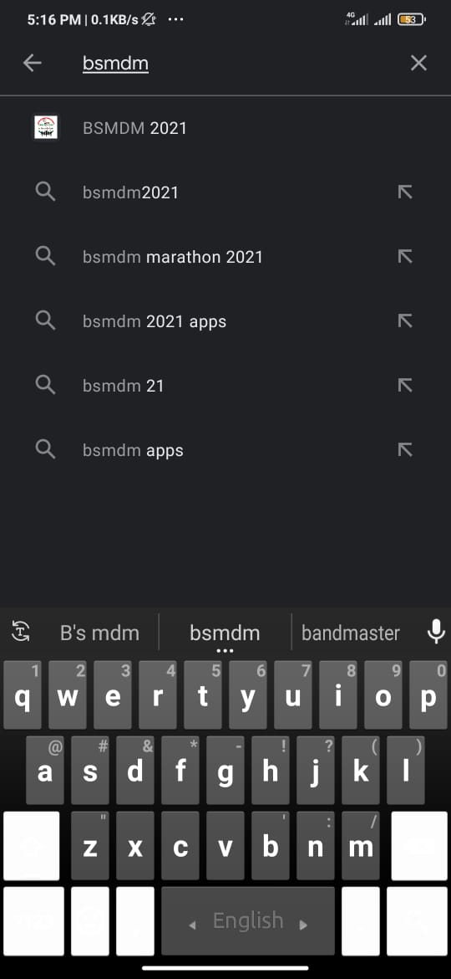
DIGITAL MARATHON REGISTRATION VIA APPS
Search BSMDM
Here
Click here

Slide 14
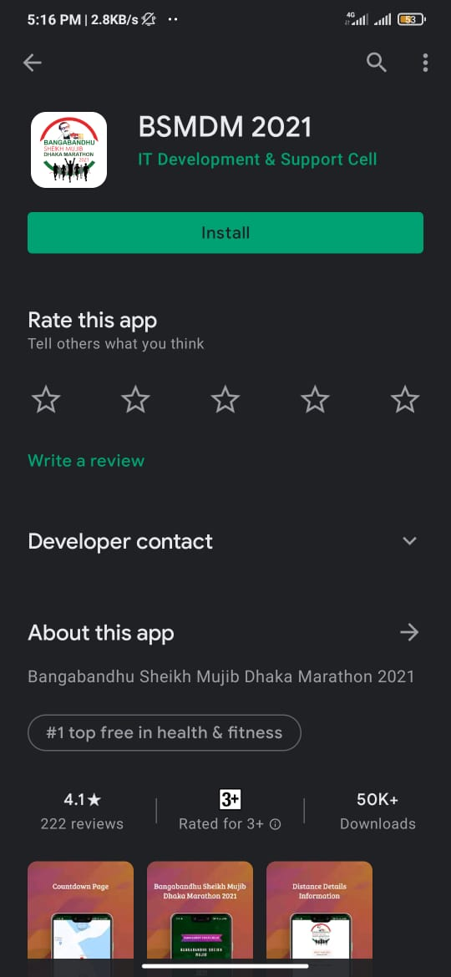
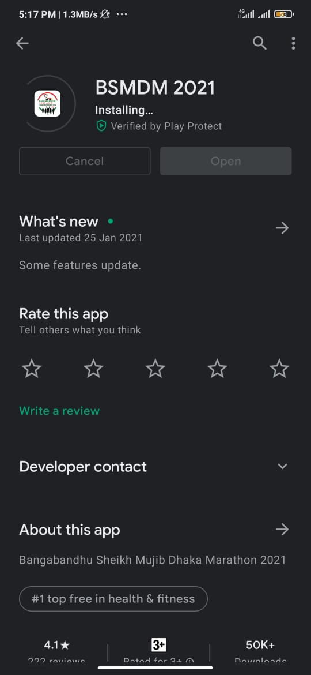
DIGITAL MARATHON REGISTRATION VIA APPS
Click Install
Click Open

Slide 15
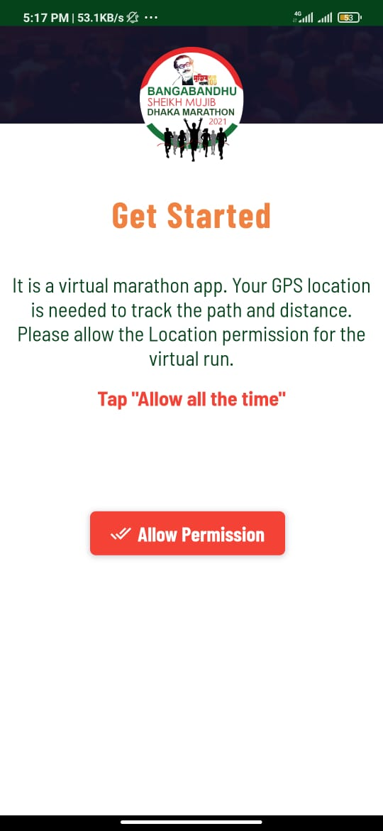
DIGITAL MARATHON REGISTRATION VIA APPS
Click here

Slide 16
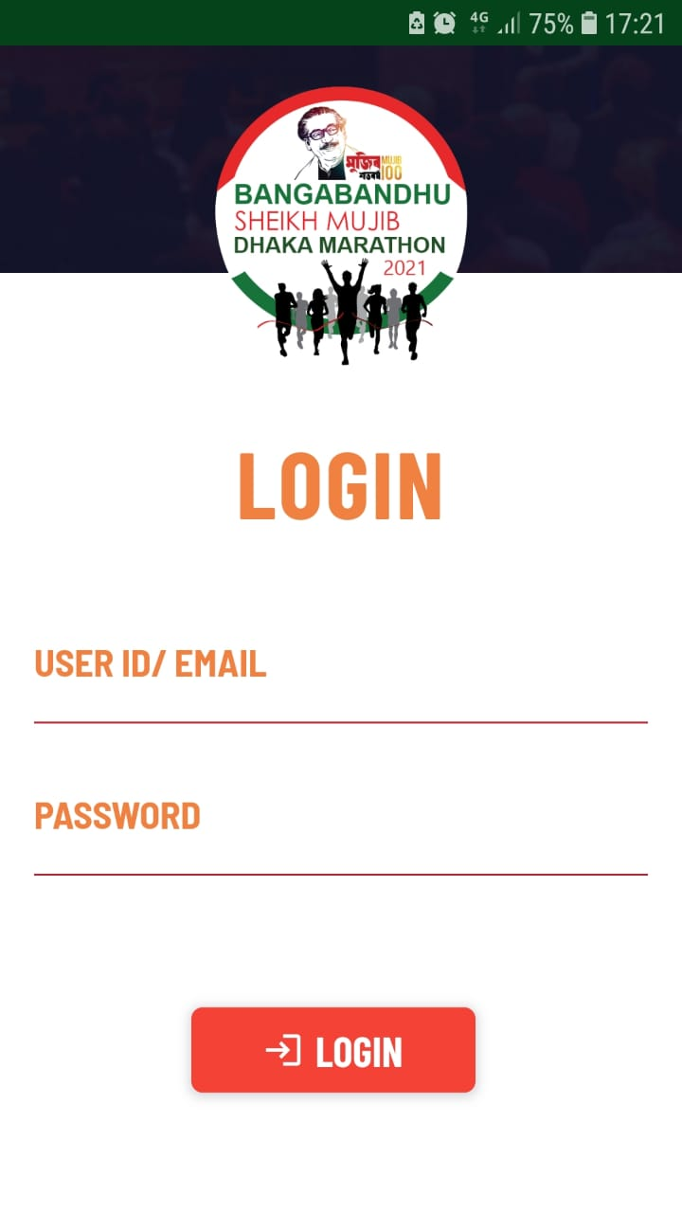
DIGITAL MARATHON REGISTRATION VIA APPS
Enter Email
abdurrahman4534@gmail.com
Enter
password
…………
Click Login

Slide 17
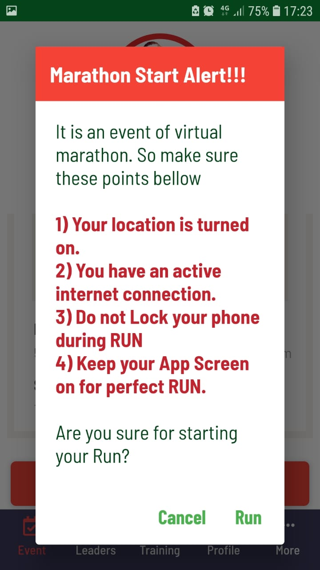
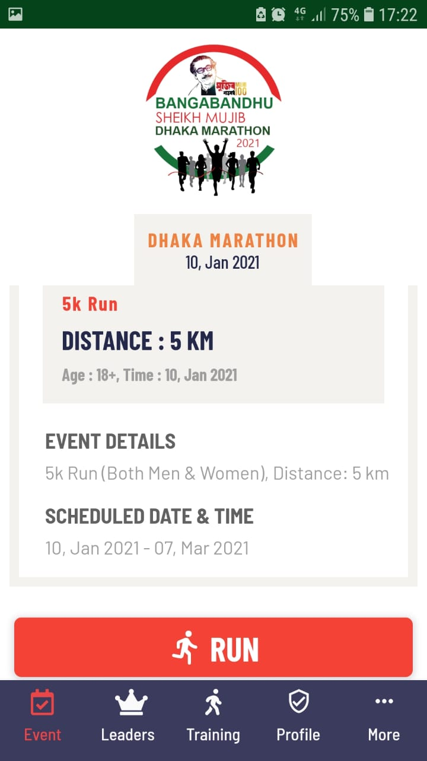
DIGITAL MARATHON REGISTRATION VIA APPS
Login Completed
To start run
Click here
Click Run

Slide 18
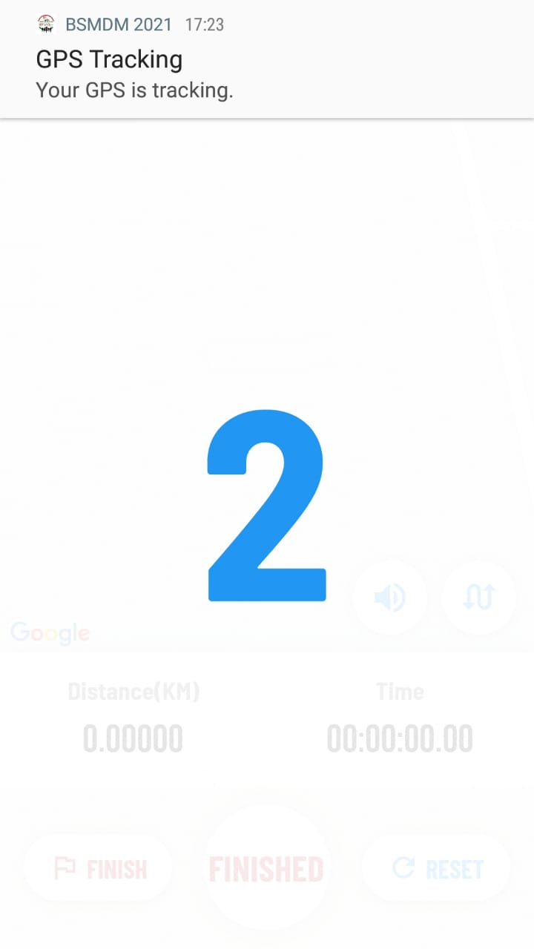
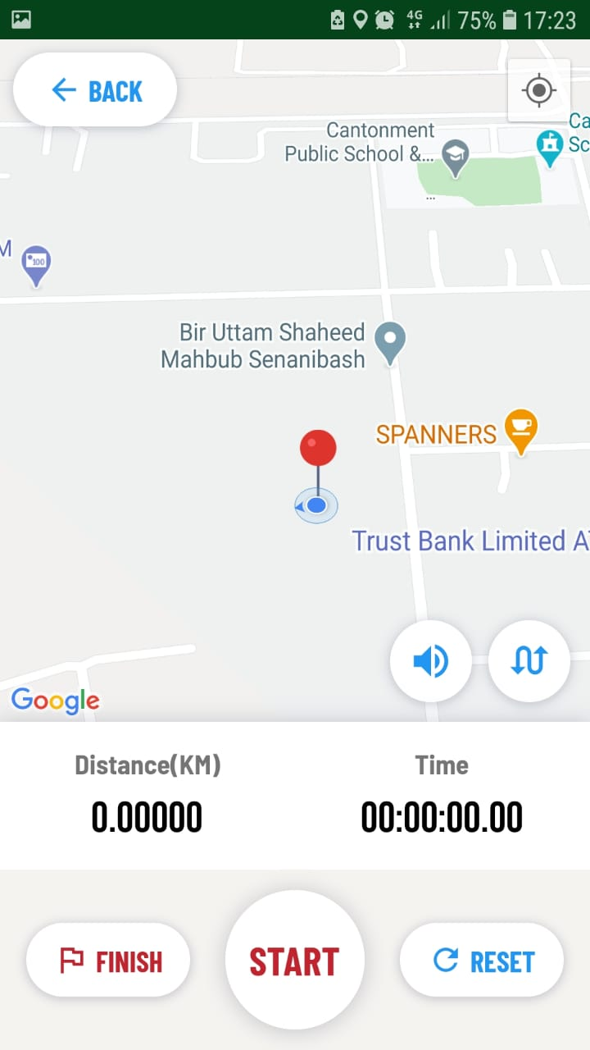
DIGITAL MARATHON REGISTRATION VIA APPS
Count down
will Start
Click Start

Slide 19
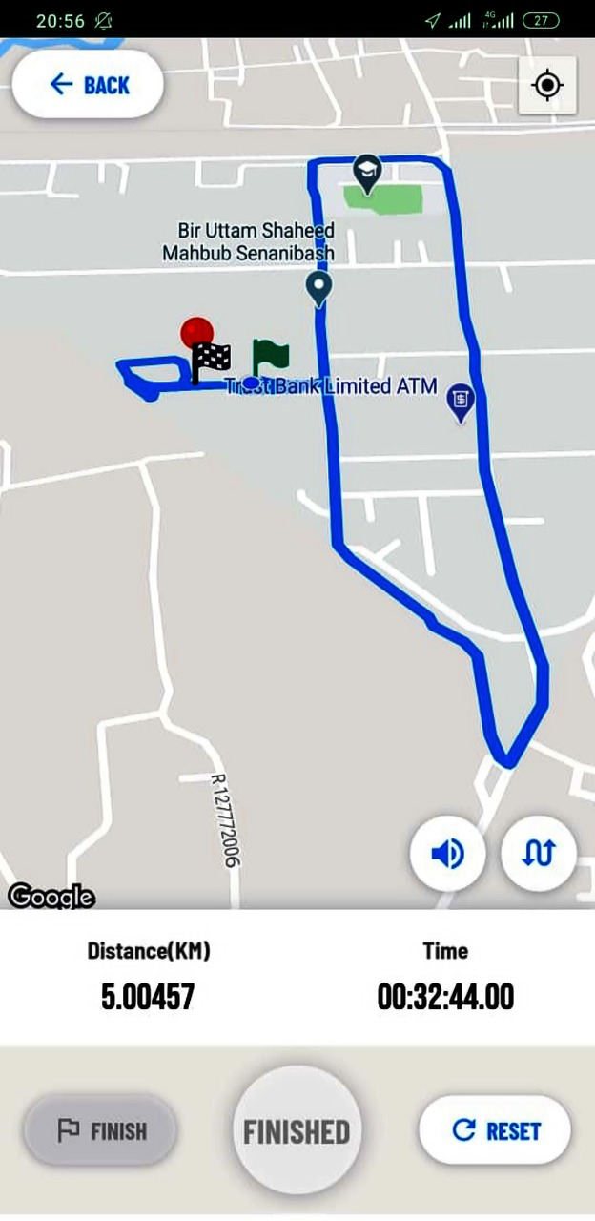
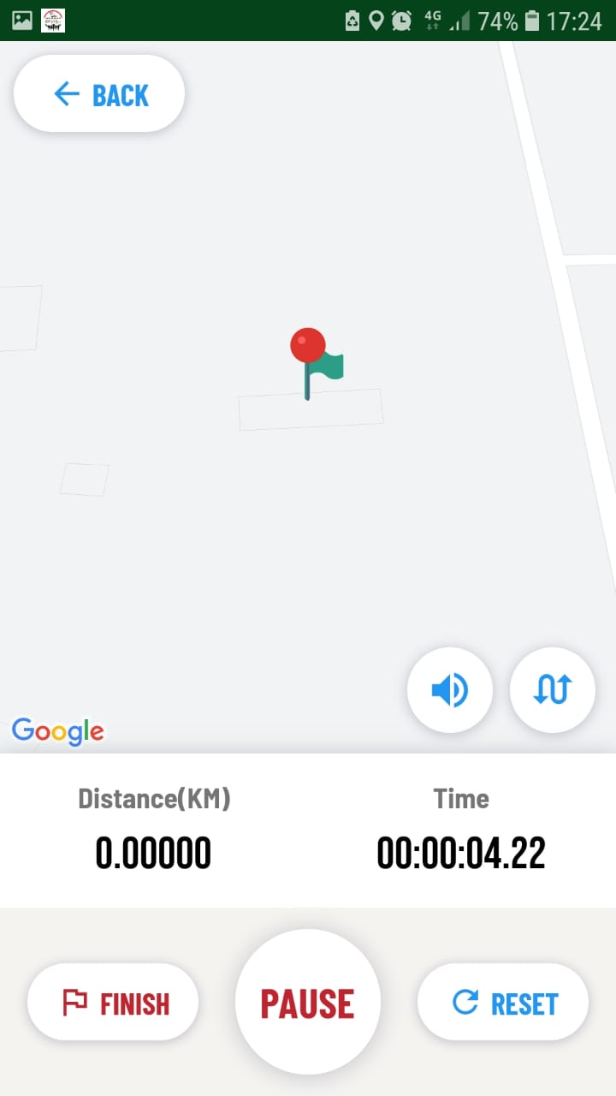
DIGITAL MARATHON REGISTRATION VIA APPS
Map of the
route will be
Shown here
Time and
distance
will be
shown here

Slide 20
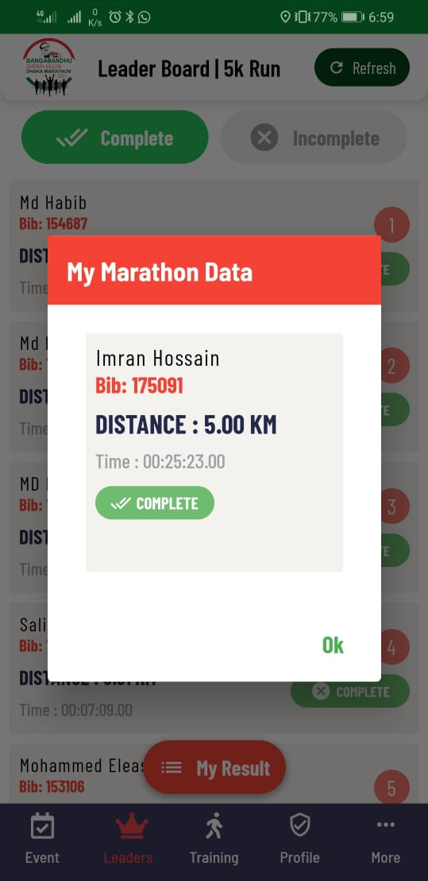
DIGITAL MARATHON REGISTRATION VIA APPS
After completion
automatically
this window
will appear

Slide 21
PROGRESS STATE
Mil pers regn tgt is achieved
Units/Bde Gps engaged with corres civ auth
Cabinet Div Dir 18 Jan 21 (Mega Asrayon Proj on 23 Jan)
Liaison/coord visit to AOR

Slide 22
PROGRESS STATE
DISTRICT | TOTAL POP | TARGET | TOTAL REGISTERED | TOTAL RUN COMPLETED | TOTAL | REMARKS (%)
DINAJPUR | 31.09 Lac | 13,000 | 1 | 0 | 0/13,500 | 0%
RANGPUR | 29.96 Lac | 25,000 | 0 | 0 | 0/15,000 | 0%
GAIBANDHA | 24.72 Lac | 8,000 | 500 | 200 | 200/8,000 | 2.5%
NILPHAMARI | 19.07 Lac | 8,000 | 0 | 0 | 0/8,000 | 0%
KURIGRAM | 20.59 Lac | 5,000 | 0 | 0 | 0/10,000 | 0%
THAKURGAON | 14.67 Lac | 10,000 | 80 | 0 | 0/10,000 | 0%
PANCHAGAR | 9.87 Lac | 6,000 | 0 | 0 | 0/6,000 | 0%
LALMONIRHAT | 12.56 Lac | 5,000 | 0 | 0 | 0/10,000 | 0%
TOTAL | 1.6 Crore | 70,000 | 581 | 200 | 200/80,500 | 0.25%
562/70,000
237
(.3%)
(.8%)
0.25%
23

Slide 23
RECOMMENDATIONS/ ACTION PLAN
Core Coord Committee at Division Level (1x Focal Pt Offr from each Dist/UZ, daily updt, weekly conf/VTC)
Corresponding military focal person will liaison
Media Campaign
Print & Elec media
Announcement; mob/static booth
Cable Ch TVC

Slide 24
RECOMMENDATIONS/ ACTION PLAN
Showcase Marathon at 3 Cantonments (in presence of local notables)
Estb of Regn Camp (around cantts/dists)
Coord & integration with sports clubs, social/cultural org/inst
Coord & integration with edn inst

Slide 25
RECOMMENDATIONS/ ACTION PLAN
Coord & integration with LEA; BGB, RAB, Police, Ansar
Recognition ( AIMS Cert, Dig Medal)
Deadline – 28 Feb 2021

Slide 26
OPEN FORUM

Slide 27
THANK YOU

